Slide 1
Career Pathways and Informed Decisions Year 13 General Studies PowerPoint 1
rhscareers

Slide 2
Career Pathways
After completing A levels you will have to decide between the following career pathways –
Degree – Higher Education - university (or college)
Diplomas, Higher Diplomas & Foundation Degrees – Further Education College
Company schemes – Deloitte, PwC (Higher Apprenticeship), Bombardier (Apprenticeship)
Employment - Kainos (IT Company), Beggs (Plumbing and Bathrooms), Santander etc

Slide 3
Qualifications and Credit Framework
Level | Title | Equivalent to
8 |  | Doctorates
7 | Postgraduate Diploma in Personnel and Development | Masters Degrees Postgraduate Certificates and Diplomas
6 | Graduate Diploma in Purchasing and Supply | Bachelor Degrees Graduate Certificates and Diplomas
5 | BTEC Level 5 Higher National Diploma | Foundation Degrees Higher National Diplomas Diplomas of Higher and Further Education
4 | Diploma in Administration Management | Certificates of Further Education
3 | BTEC Extended and NVQ Diplomas BTEC Level 3 Diploma BTEC Level 3 Subsidiary Diploma | Three GCE A Levels Two GCE A Levels One GCE A Level
2 | BTEC Level 2 Diploma BTEC Level 2 Extended Certificate | Four GCSEs A*-C Two GCSEs A*-C
1 | BTEC Level 1 Certificate/Award | GCSEs D-G
Higher Education
Further Education

Slide 4
Further Education Colleges
BTEC, OCR, City and Guilds etc – work-related qualifications which are available in a wide range of subjects (level 3)
AS and A levels are also level 3 and taught at FE colleges.
Higher National Diploma (HND) – again vocational level 5 qualifications which focus on learning by doing.
Foundation Degree – provide technical skills and academic knowledge. Foundation Degrees and HNDs feed into 2nd year of a related degree course.
Degree – designed to give you a thorough understanding of a subject and to develop your analytical, intellectual and communication skills.

Slide 5
Apprenticeships
Level 2 & 3 Appr​​enticeships - You must be employed to gain entry. Your week is split between working for an employer and attending the College eg Carpentry and electrical installation at SERC.
IT Apprenticeships (level 2 & 3)– over 80 students recruited since 2012 for software development and IT infrastructure roles (Belfast Met)
Higher Apprenticeships (level 4 or 5) – aimed at post-A level students and designed to help those in work to develop higher skill levels and include qualifications which are work-related eg Diploma of Accounting Technicians (level 5) at Belfast Met.

Slide 6
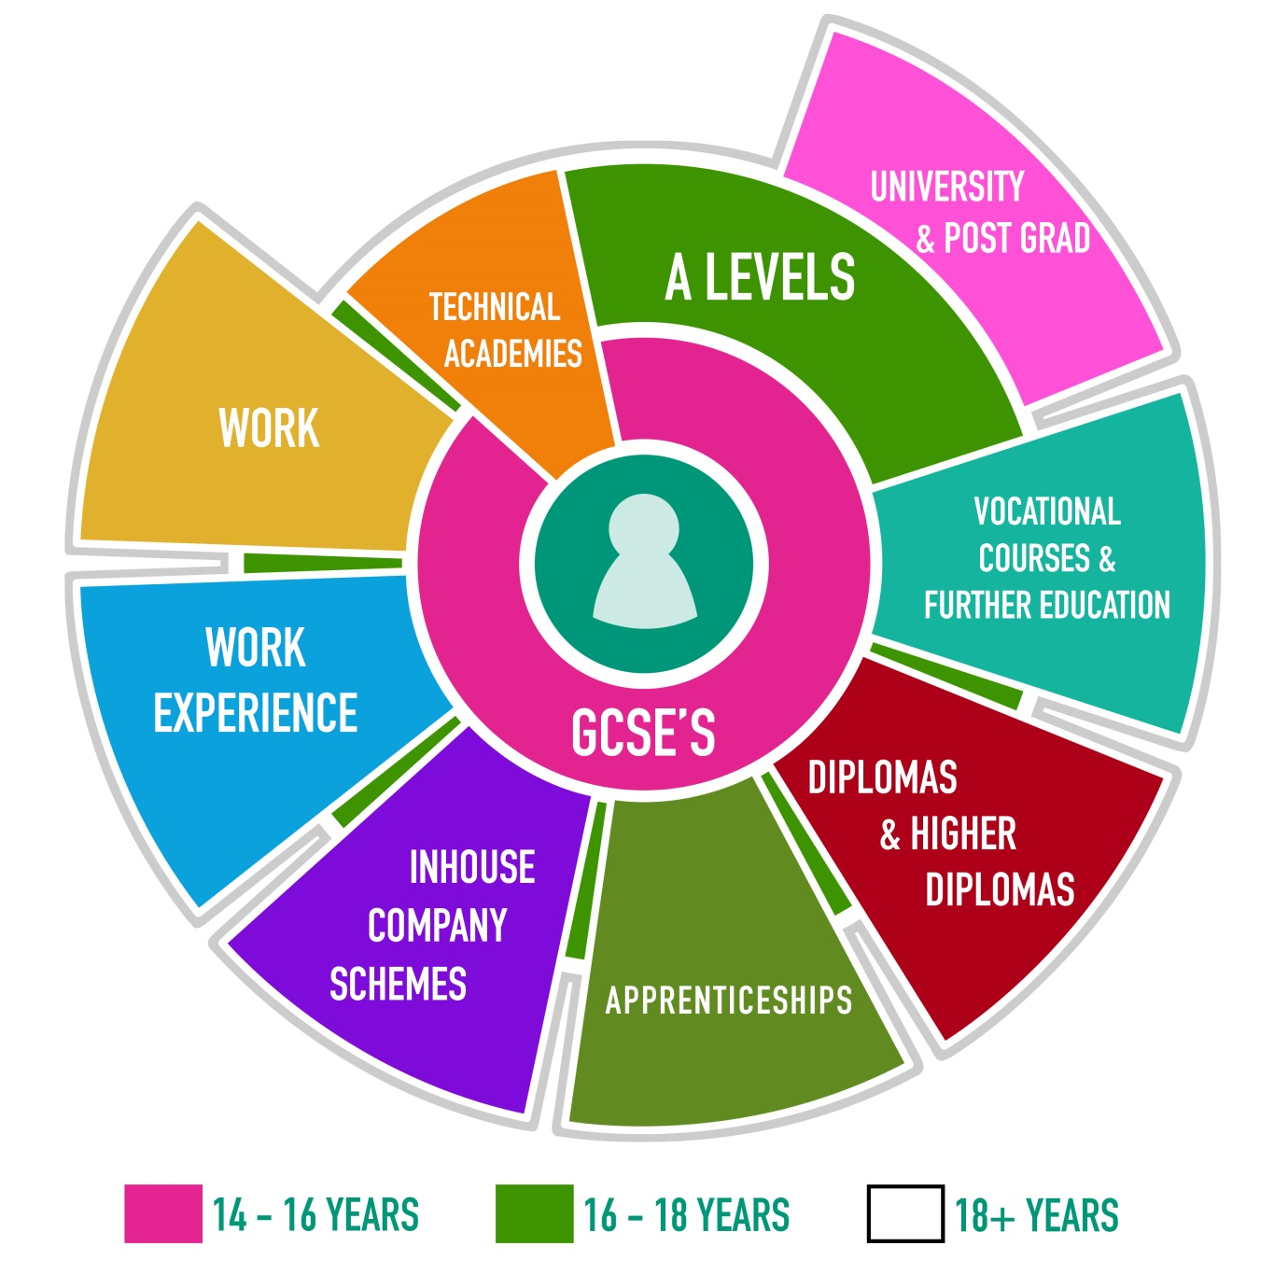
Consider your current career pathway options and record them on page 1 of your Careers Booklet -

Slide 7
Making Decisions
Your career choice and pathway will have a great effect on the rest of your life so it is important to spend time and energy making decisions.

Slide 8
Steps to follow -
Identify your own skills, qualities & interests.
Research and compare careers which match your own profile
Contrast and compare different universities / colleges
Carefully check entry requirements for any selected courses – A level subjects and grades, AS subjects and grades, GCSE subjects and grades, work experience and admission tests may all be required.

Slide 9
Gathering Information b Knowledge is the key to making informed decisions!
Websites – www.ucas.com, www.sacu-student.com, www.icould.com, www.whatuni.com, www.bestcourse4me.com, www.push.co.uk and www.guardian.co.uk/education/universityguide.
Student Room
School’s destinations database
Attend as many open days as possible
Attend taster courses if available
Attend RHS Careers Convention and UCAS Convention

Slide 10
Open Days, Taster Courses & Conventions
Open Days – attending uni and college open days will not only give you a feel for the place but also enable you to gather information from lecturers and current students.
Taster Courses usually last from 2 to 4 days and give you the opportunity to experience a uni’s academic and social life.
Careers and UCAS Conventions provide an excellent opportunity to speak to admission tutors and graduate employers.

Slide 11
Open Days – see www.search.ucas.com (full list), RHS Careers Facebook page and individual uni websites.
Taster Courses - RHS Careers Facebook page and uni websites.
Careers and UCAS Conventions – RHS Careers, FE and HE Convention will be on 28th January 2016 and the UCAS Convention will be during the first week of March.
Record the details of any Open Days or Taster courses you would like to attend on page 1 of your Careers Booklet.

Slide 12
In all cases, it is essential that you prepare questions before you go!
In groups of 3 or 4, discuss what sort of questions you should ask at open days, taster courses and conventions………

Slide 13
Possible Questions – Unis / Colleges
What are the travel costs to / from uni?
What are the accommodation costs?
What are the tuition fees?
What commitments do I have at home?
Is accommodation guaranteed in 1st year?
Where is the uni/course in the Times / Guardian league tables?
How is the course taught?
How is the course assessed?

Slide 14
Will I have the opportunity to study abroad?
Will I have the opportunity to gain work experience during my degree?
What is the graduate employment rate?
Where are graduates employed?
What do graduates do?
What clubs/societies are available?
What sports teams can I join?
What support is available for new students?
What are the entry requirements?

Slide 15
Possible Questions – Employers
What is your educational background?
Do your company sponsor undergraduates?
What are the different pathways available?
How has your career developed since you joined the company?
What opportunities for training are available?
Do you travel much?
What is your work / life balance like?
What are the pros / cons of your job?
Would you recommend this area of employment?

Slide 16
Your Questions and Answers
List all of the questions that are most important to you on page 2 of your Careers Booklet.
As you attend open days, taster courses and conventions, fill in the answers.
You should aim to have all of your questions answered by the end of Year 13.

