Slide 1
Further or Higher Education?
Year 13 General Studies
PowerPoint 2
rhscareers

Slide 2
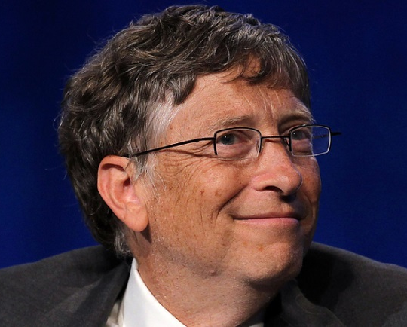
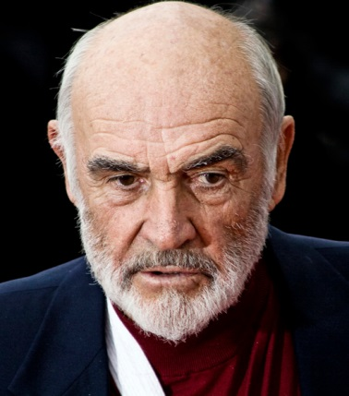
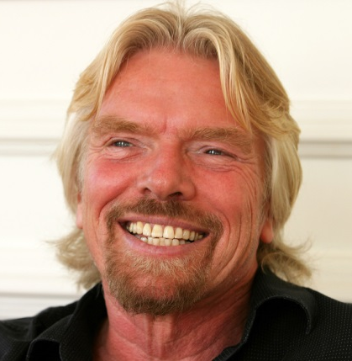
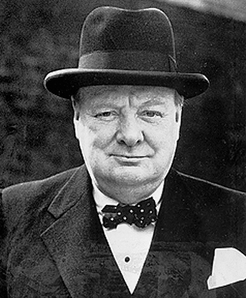
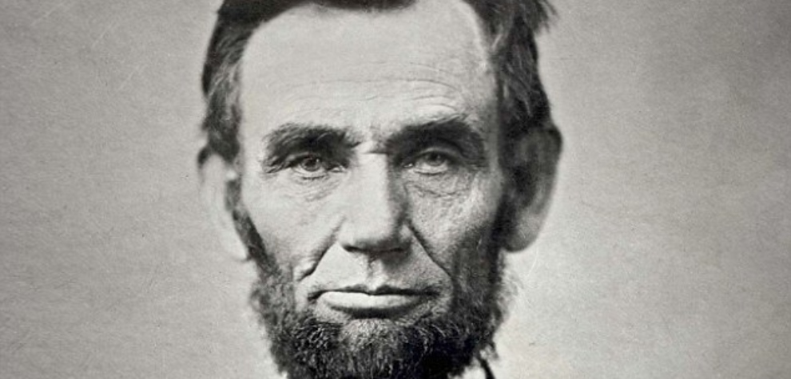
What do Winston Churchill, Ralph Lauren, Steve Jobs, Richard Branson, Sean Connery, Abraham Lincoln, Bill Gates and Karen Brady all have in common?

Slide 3
None of them have a degree!

Slide 4
Sir Winston Churchill was Prime Minister and widely regarded as one of the greatest wartime leaders of the 20th century. He was also an historian, a writer and an artist; He won the Nobel prize in Literature.
Ralph Lauren has a net worth of $7 billion. The fashion tycoon went to university for 2 years but left to join the army.
Steve Jobs has a net worth of $8.3 billion. The late Apple co-founder attended university in Oregon, but left after 6 months.

Slide 5
Richard Branson - Music, airlines, comics, stem cell research, space tourism. Dyslexic Branson struggled in school and his headmaster told him he’d either end up a prisoner or a millionaire.
Sir Sean Connery is a Scottish actor and producer who has won an Academy Award, two BAFTA Awards and three Golden Globes. He was knighted in July 2000.
Abraham Lincoln, U.S. president. Finished one year of formal schooling. Studied on his own to become a lawyer.

Slide 6
Bill Gates, the world’s richest man, dropped out of Harvard University to co-found Microsoft. Estimated to be worth over $76 billion.
Karren Brady, Baroness Brady is the former managing director of Birmingham City FC and current vice-chairman of West Ham United. She features in The Apprentice and is currently the Small Business Ambassador to the Prime Minister, David Cameron.

Slide 7
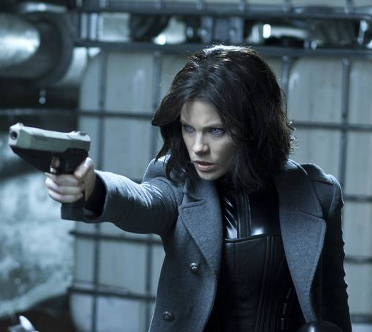
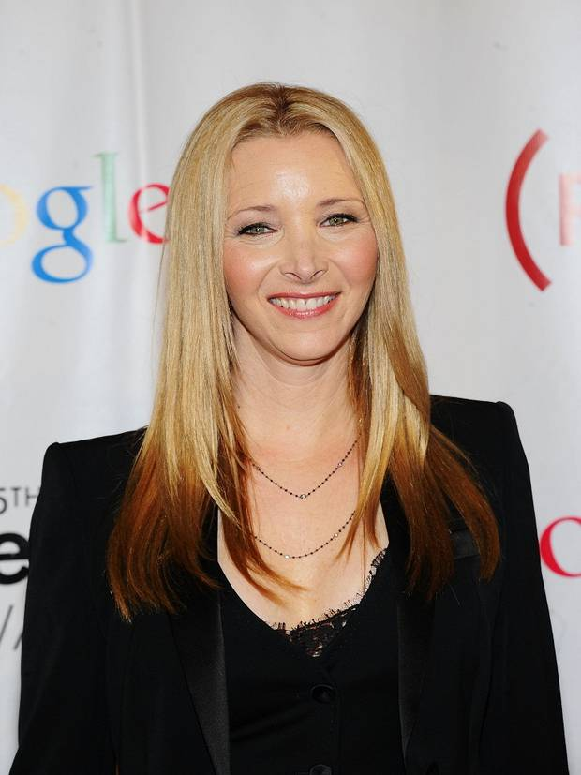
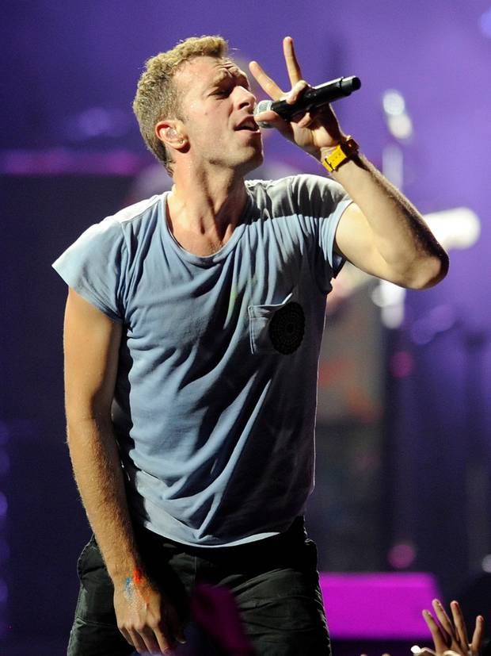
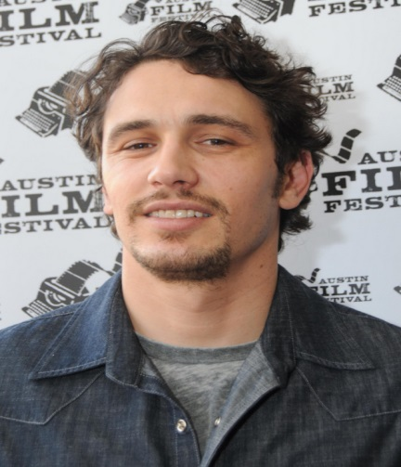
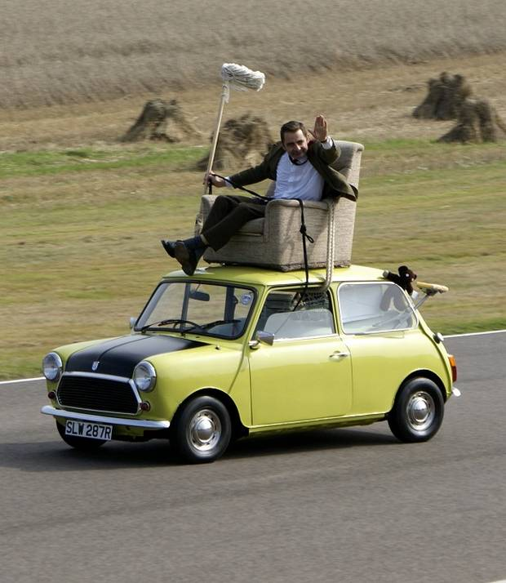
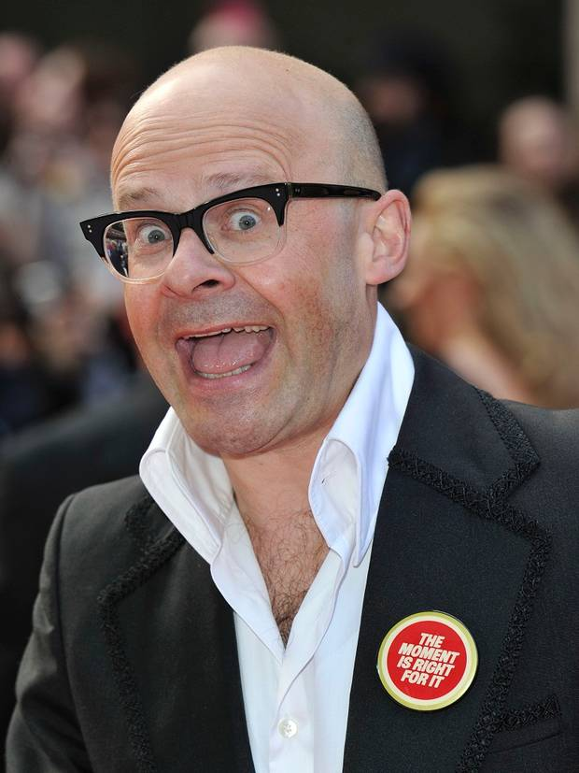
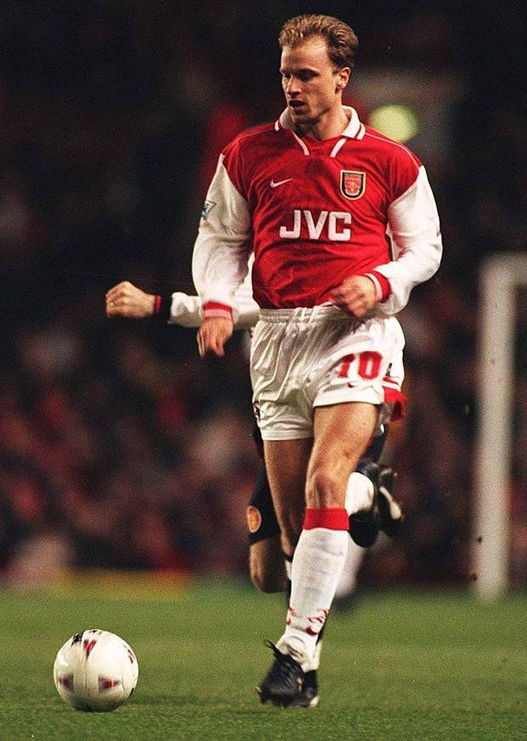
What do Rowan Atkinson, Chris Martin, Kate Beckinsale, Lisa Kudrow, Harry Hill, James Franco and Denis Bergkamp have in common?

Slide 8
They all have degrees!

Slide 9
Rowan Atkinson - Electrical Engineering, Newcastle University. Gained the highest marks in his year before going on to Oxford to study for an MSc.
Kate Beckinsale – French and Russian Literature, Oxford Uni. Actress - known for playing vampires and hunting werewolves.
Dennis Bergkamp – Mechanical Engineering, Uni of Bath. Took his degree while playing for Arsenal.
Harry Hill – Neurosurgery, University of London. Hill remains on the General Medical Council’s list of Register Medical Practitioners.

Slide 10
Chris Martin – Greek and Latin, UCL. Finished his final exams (obtaining a 1st class degree) before agreeing to promote Coldplay’s first album.
James Franco – English, University of California. While at the uni, he studied French, the Holocaust, philosophy of science, and American literature among other things.
Lisa Kudrow – Psychobiology, Vassar College. Researched headaches for eight years while trying to break into acting.

Slide 11
Should you go to university?
Going to university has never been more popular. However, with mounting student debts and thousands of graduates struggling to get a job, it’s worth considering alternative career pathways such as –
FE Colleges- BTECs, HNDs, foundation degrees
Apprenticeships
Employment – management training schemes / professional qualifications / higher apprenticeships / internships

Slide 12
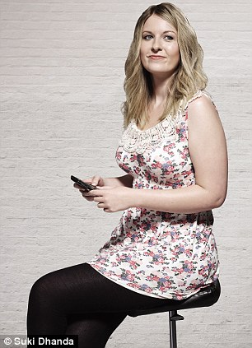
1. THE CELEBRITY JOURNALIST
Sophie Eager, 21, found her dream job as an online celebrity news writer earning £18,000 just four months after doing a ten-week course in journalism.

Slide 13
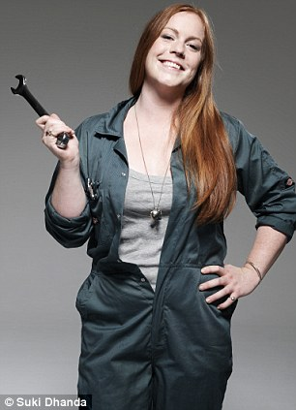
2. THE TRAINEE PLUMBER
Rose Llewellyn, 23, daughter of Sir Roddy Llewellyn, left Marlborough College at 18 with three A-levels and planned to go to university. After a gap year she changed tack, deciding to become a plumber.

Slide 14
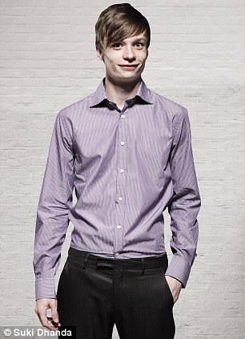
3. THE ACCOUNTANT
Tom Gee, 19, achieved A*AA at A-level but went straight from his grammar school to work as a trainee accountant for Pricewaterhouse Coopers. He lives with his parents in Worcestershire, and earns £16,000 a year.

Slide 15
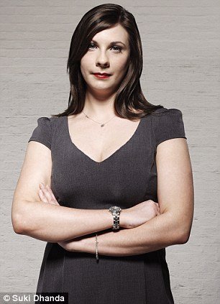
4. THE MARKETING EXECUTIVE
Claire Smith, 22, turned down four university places to start her own food gift business, aged 18. Since March this year, she’s been working in marketing for preserves manufacturer Mackays.

Slide 16
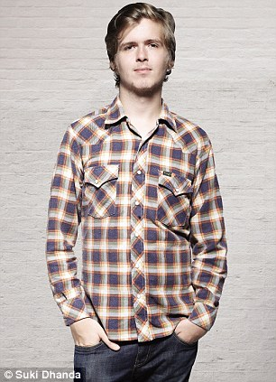
5. THE RECORD COMPANY PR
Ned Hodge, 20, got his first job in the music business at 18, having left school with a BTEC Diploma in business studies and an AS-level in English language. He is now online press and marketing manager for Rough Trade Records. He rents with friends in Clapton, East London, and earns £22,000 a year.

Slide 17
Does it Pay to Study?
Most students now leave university with a debt of between £20,000 and £45,000.
Higher Education should be viewed as an investment.
Look at the following table and compare the earning potential (2014) for employees by qualifications and age.
Answer the questions which follow.

Slide 18
Age | Degree | A-Level | GCSE
21-25 | £21,500 | £17,760 | £13,250
26-30 | £26,750 | £19,230 | £15,220
31-35 | £33,350 | £23,900 | £17,920
36-40 | £38,800 | £26,150 | £18,270
41-45 | £41,560 | £26,890 | £17,990
46-50 | £47,790 | £26,240 | £18,350
51-55 | £54,280 | £24,560 | £18,250
56-60 | £57,950 | £23,290 | £18,440
All ages 21-60 | £40,247 | £23,503 | £17,211

Slide 19
Estimate the age you would expect to break even on your investment if you acquire a student debt = £30,000. Assume you pay back 10% of all income above £20,000.
Estimate the financial benefits you would expect to build up throughout your working life (minus cost of study).
List the main non-financial benefits of Higher Education that are most important to you.

Slide 20
1. Student Debt = £30,000 Assume you pay back 10% of income above £20,000. Age 21 to 25 - 10% of 1,500 = £150 x 5 = £750 Age 26 to 30 - 10% of 6,750 = £675 x 5 = £3,375 Age 31 to 35 - 10% of 13,350 = £1,335 x 5 = £6,675 Age 36 to 40 - 10% of 18,800 = £1,880 x 5 = £9,400 Age 41 to 45 – 10% of 21,560 = £2,156 x 5 = £10,780 Total = £30,980 Therefore, you will be 45 years old before all student debts are paid off!

Slide 21
2.
Age | Degree | A-Level
21-25 | £21,500 | £17,760
26-30 | £26,750 | £19,230
31-35 | £33,350 | £23,900
36-40 | £38,800 | £26,150
41-45 | £41,560 | £26,890
46-50 | £47,790 | £26,240
51-55 | £54,280 | £24,560
56-60 | £57,950 | £23,290
Total of all ages | £1,609,880 - £30,000 = £1,579,880 | £940,120
A graduate will earn 1,579,880 – 940,120 = £639,760
more than a non-graduate over their working life.

Slide 22
3. Answers may include-
Vocational programme of study – accountancy, sports science, nutrition etc
Degree required for entry to some careers – medicine, chartered engineering, teaching etc
Improves earning potential / job satisfaction
Develops transferrable skills – communication, ability to learn, problem solving etc
Meet students from different cultures / beliefs
Seminars let you challenge others’ views
Study for personal interest and pleasure

Slide 23
Graduate Jobs 2014 - Quiz
1. Which sector had the highest number of graduate vacancies this year?
Engineering / Geography / Accounting / Media
2. Graduates of which subject have the lowest average starting salary?
Nursing / Architecture / Psychology / Geography
3. How many of last year’s university leavers were unemployed (not including further education or study) after six months?
7.5% / 6.2% / 8.4% / 9%

Slide 24
4. Which was the most popular degree course last year?
Medicine / Engineering / Nursing / Law
5. What was the average number of applications received for each graduate job this year?
39 / 56 / 72 / 87
6. What proportion of UK graduates who completed their degree in the year 2012-13 were in either full-time or part-time work, six months after finishing their degree?
81.6% / 77.3% / 70.5% / 63.7%

Slide 25
7. Which university had the highest percentage of graduates in employment after six months?
Oxford University / Ulster University /
Southampton University / Imperial College London
8. Around how many graduates entered the job market this summer?
290, 000 / 350,000 / 410,000 / 500,000
Now check your score!

Slide 26
Answers
1. Which sector had the most graduate vacancies? Accounting
2. Graduates of which subject have the lowest average starting salary? Architecture
3. How many 2014’s graduates were unemployed after ½ yr? 6.2%
4. Which was the most popular degree course last year? Nursing
5. What was the average number of applications received for each graduate job this year? 39
6. What proportion of UK graduates who completed their degree in the year 2012-13 were in either full-time or part-time work, six months after finishing their degree? 77.3%
7. Which university had the highest percentage of graduates in employment after six months? Imperial College London
8. Around how many graduates entered the job market this summer? 350,000

Slide 27
University or Not?
No-one can advise you whether to go to university
or not. It is entirely your own decision but it is
extremely important to ensure that it is an informeddecision, based on facts and not hearsay.
In small groups discuss the advantages and disadvantages of FE, HE and getting a job after 6th Form.
Summarise your thoughts in the tables at the bottom of page 3 in your Careers Booklet.

Slide 28
Further Research
Use the following websites to gain as much information as possible about FE and HE options –
www.belfastmet.ac.uk
www.serc.ac.uk
www.qub.ac.uk
www.ulster.ac.uk
www.bestcourse4me.com
www.push.co.uk
www.sacu-student.com
www.ucas.com
www.icould.com

